Slide 1
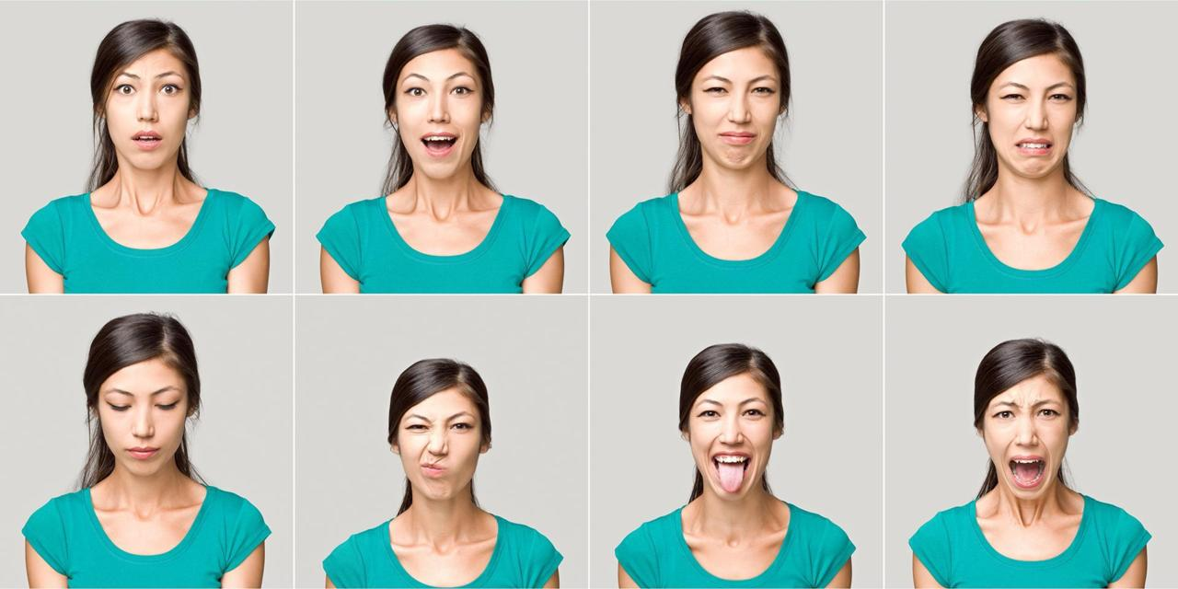

Slide 2
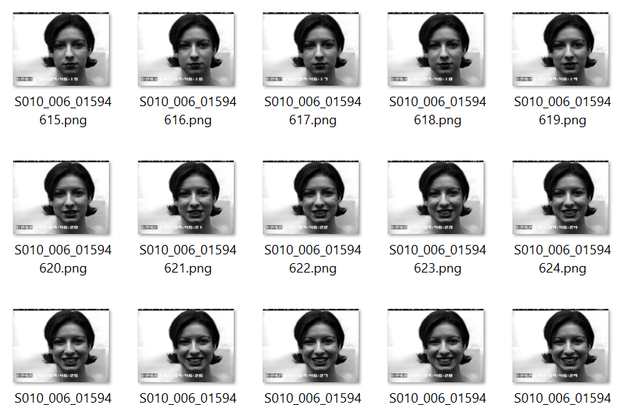
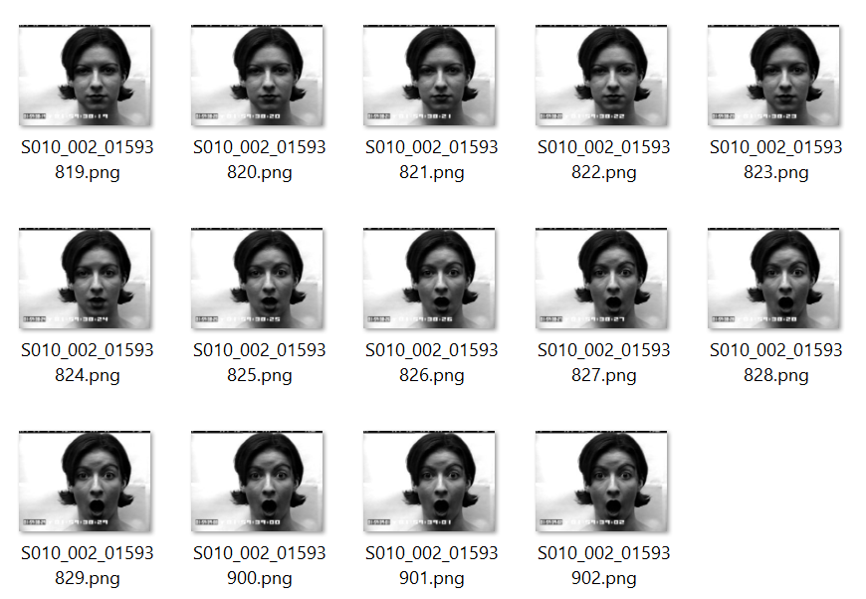
Dataset
neutral = {'code': ' 0.0000000e+00', 'name': 'neutral'}
 | anger = {'code': ' 1.0000000e+00', 'name': 'anger'}
 | contempt = {'code': ' 2.0000000e+00', 'name': 'contempt'}
 | disgust = {'code': ' 3.0000000e+00', 'name': 'disgust'}
 | fear = {'code': ' 4.0000000e+00', 'name': 'fear'}
 | happy = {'code': ' 5.0000000e+00', 'name': 'happy'}
 | sadness = {'code': ' 6.0000000e+00', 'name': 'sadness'}
 | surprise = {'code': ' 7.0000000e+00', 'name': 'surprise'}

Slide 3
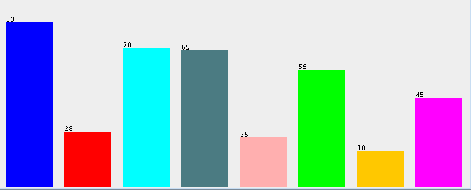
Dataset
http://www.consortium.ri.cmu.edu/data/ck/
398 image files - etiketli data
surprise sadness neutral happy fear disgust contempt anger

Slide 4
Vggface tool is used in order to extract the landmarks from the image pictures.

Slide 5
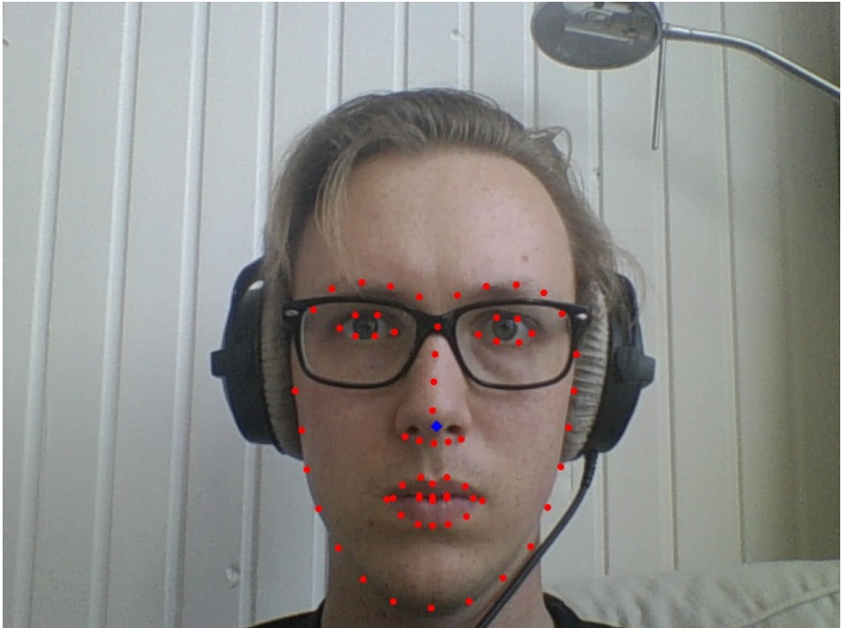
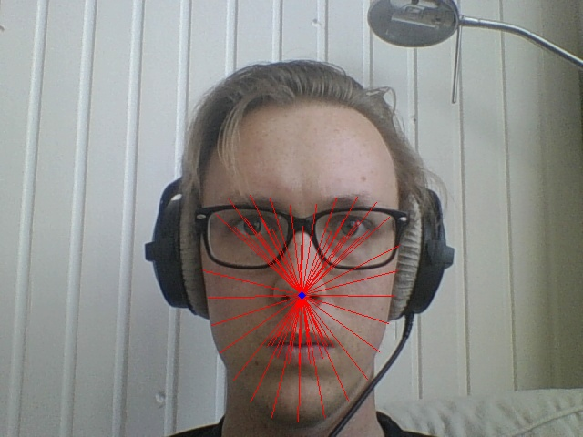
VECTORIZING

Slide 6
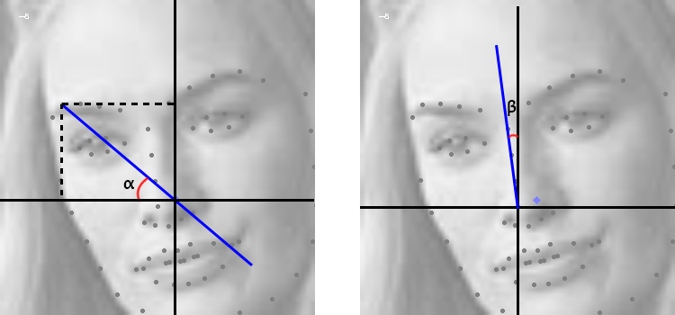
(math.atan2(y, x)*360)/(2*math.pi)

Slide 7
Machine Learning Techniques & Scores

Slide 8

Machine Learning Techniques & Scores

